Slide 1
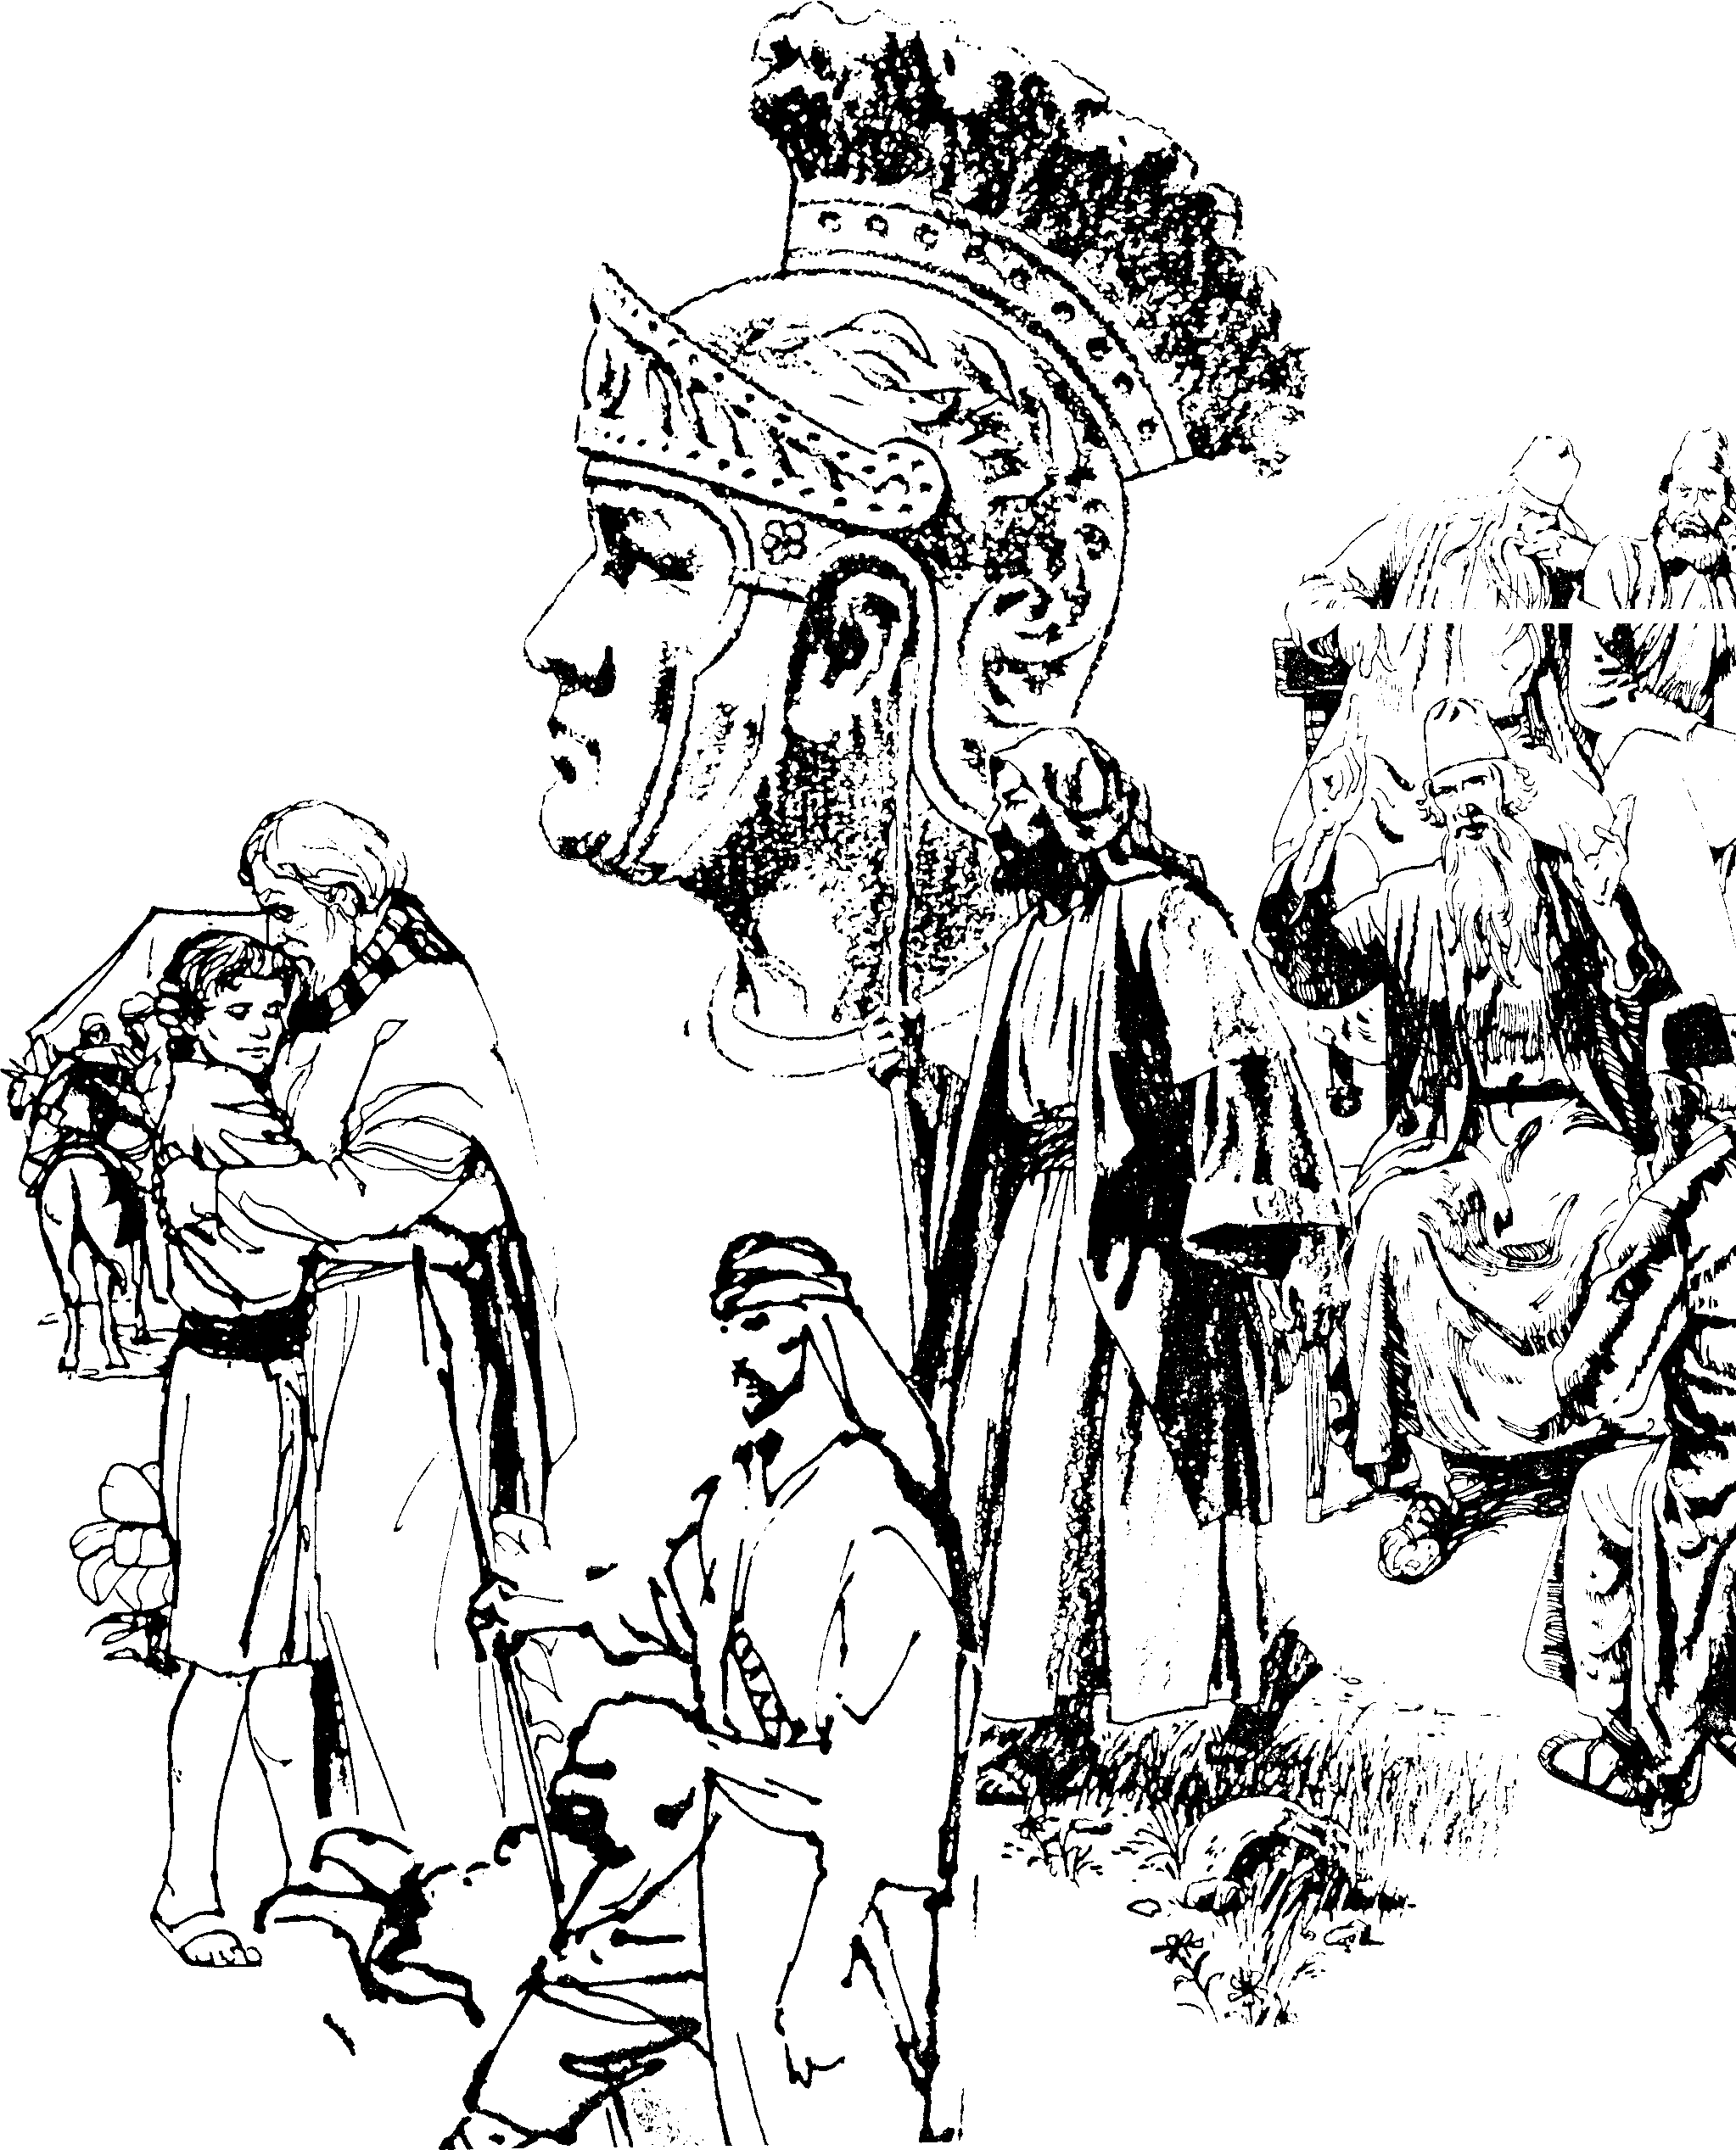
Gjpa Vw;ghl;L gpd;dzp
Dr. Rick Griffith • rpq;fg;g+H Ntjhfk fy;Y}up • BibleStudyDownloads.org
Notes:
----- Meeting Notes (1/13/11 11:56) -----
Introduction slide

Slide 2

cq;fis mwpKfk; nra;jy;
ngaH
ehL
FLk;gk;
rig
ghl Nehf;fk;
ngaH
ehL
epfo;T
FLk;gk;
rig
Copa Nehf;fk;

Slide 3
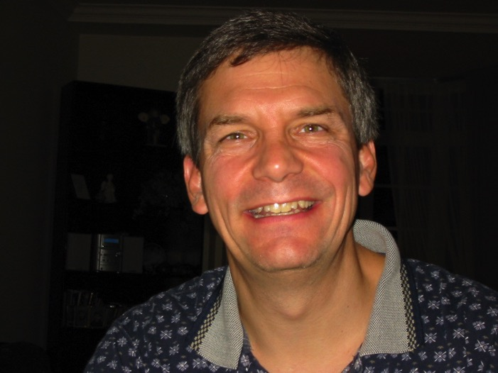

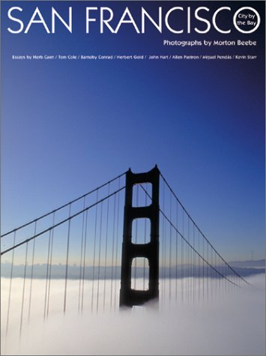
vdJ ehL

Slide 4
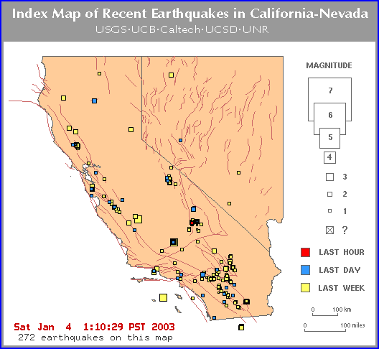
ehd; epy eLf;fj;jpd; ehl;il NrHe;jtd;

Slide 5


Our People
#rd; rig ngz;fSf;F fw;gpj;jy;
Notes:
I also lead the woman's Precept Bible study at our church

Slide 6

ngz;fs; Ntjghlk;
1-2 ,uh[hf;fs;
mnkupf;fh • ,e;jpah • rpq;fg;g+H • epA+rpyhe;J • rpk;ghNg • n`hyd;l;

Slide 7

jha;yhe;J • nkhq;Nfhypah • kpad;khH • ,e;NjhNdrpah
Notes:
INTERVIEWER: And Susan, what ministries has the Lord granted you?
SUSAN: I have been teaching the wives of leaders at SBC. These 5 women come from 5 different nations!
SUSAN: I also lead the woman's Bible study at our church

Slide 8
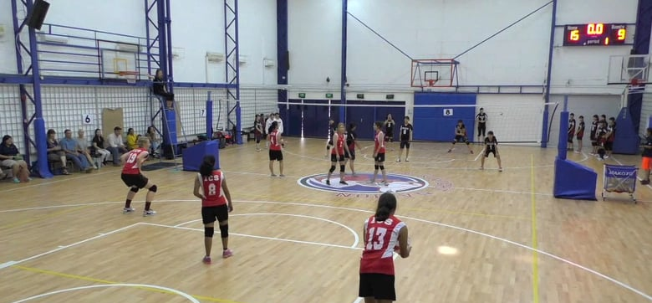
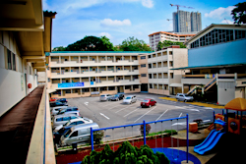
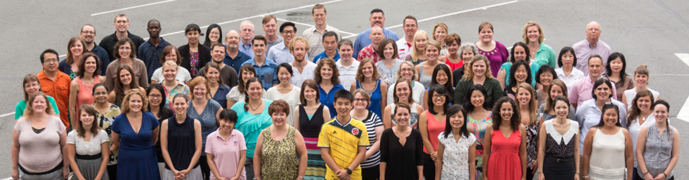
rHtNjr r%f ghlrhiy (ICS)
(Muk;gk;. 1993)

Slide 9

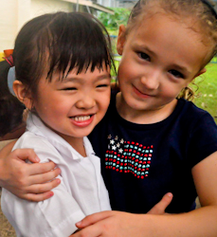

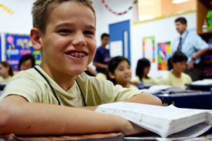
ICS jw;nghOJ 480 khztHfis nfhz;Ls;sJ.
If;fpa ,uh[;[pak;
RtPld;
nfhupah
Rtp];rHyhe;J
[g;ghd;
,j;jhyp
I. mnkupf;fh
jha;yhe;J
,e;jpah
nkf;rpNfh
ICS
ntdpRyh
,e;NjhNdrpah
gpNurpy;
njd; mnkupf;fh
mT];jpNuypah

Slide 10
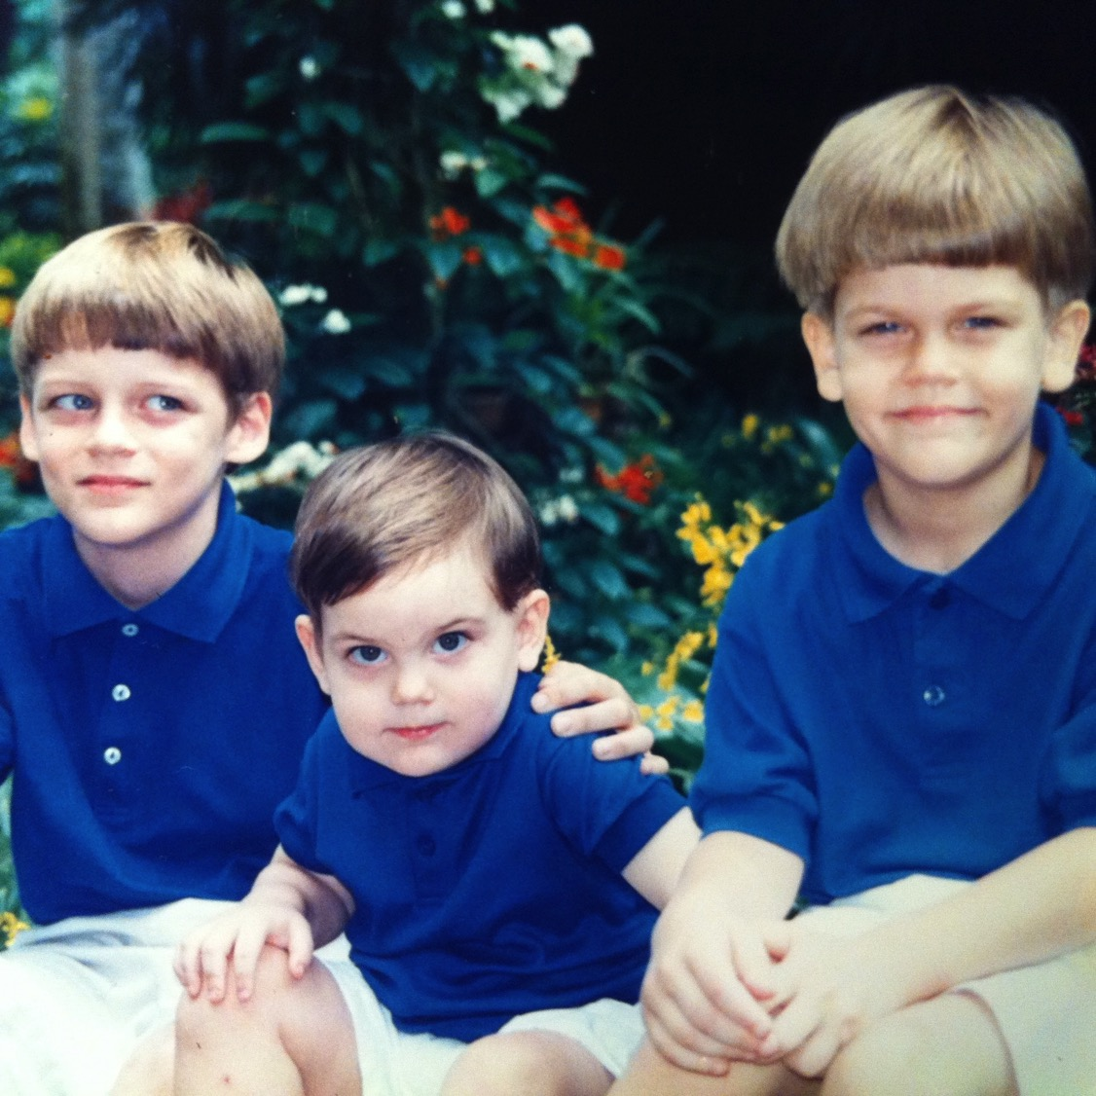
vkJ %d;W Gjy;tHfs;

Slide 11
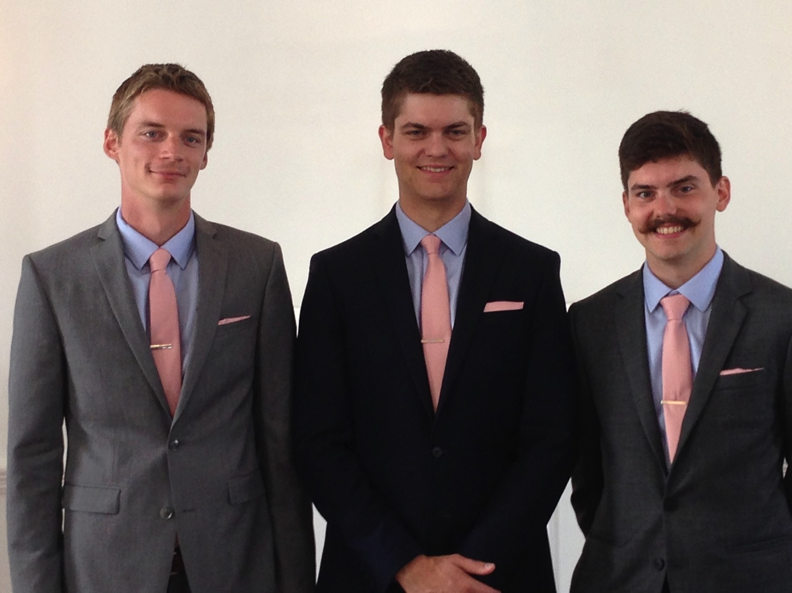
vkJ %d;W Gjy;tHfs;

Slide 12
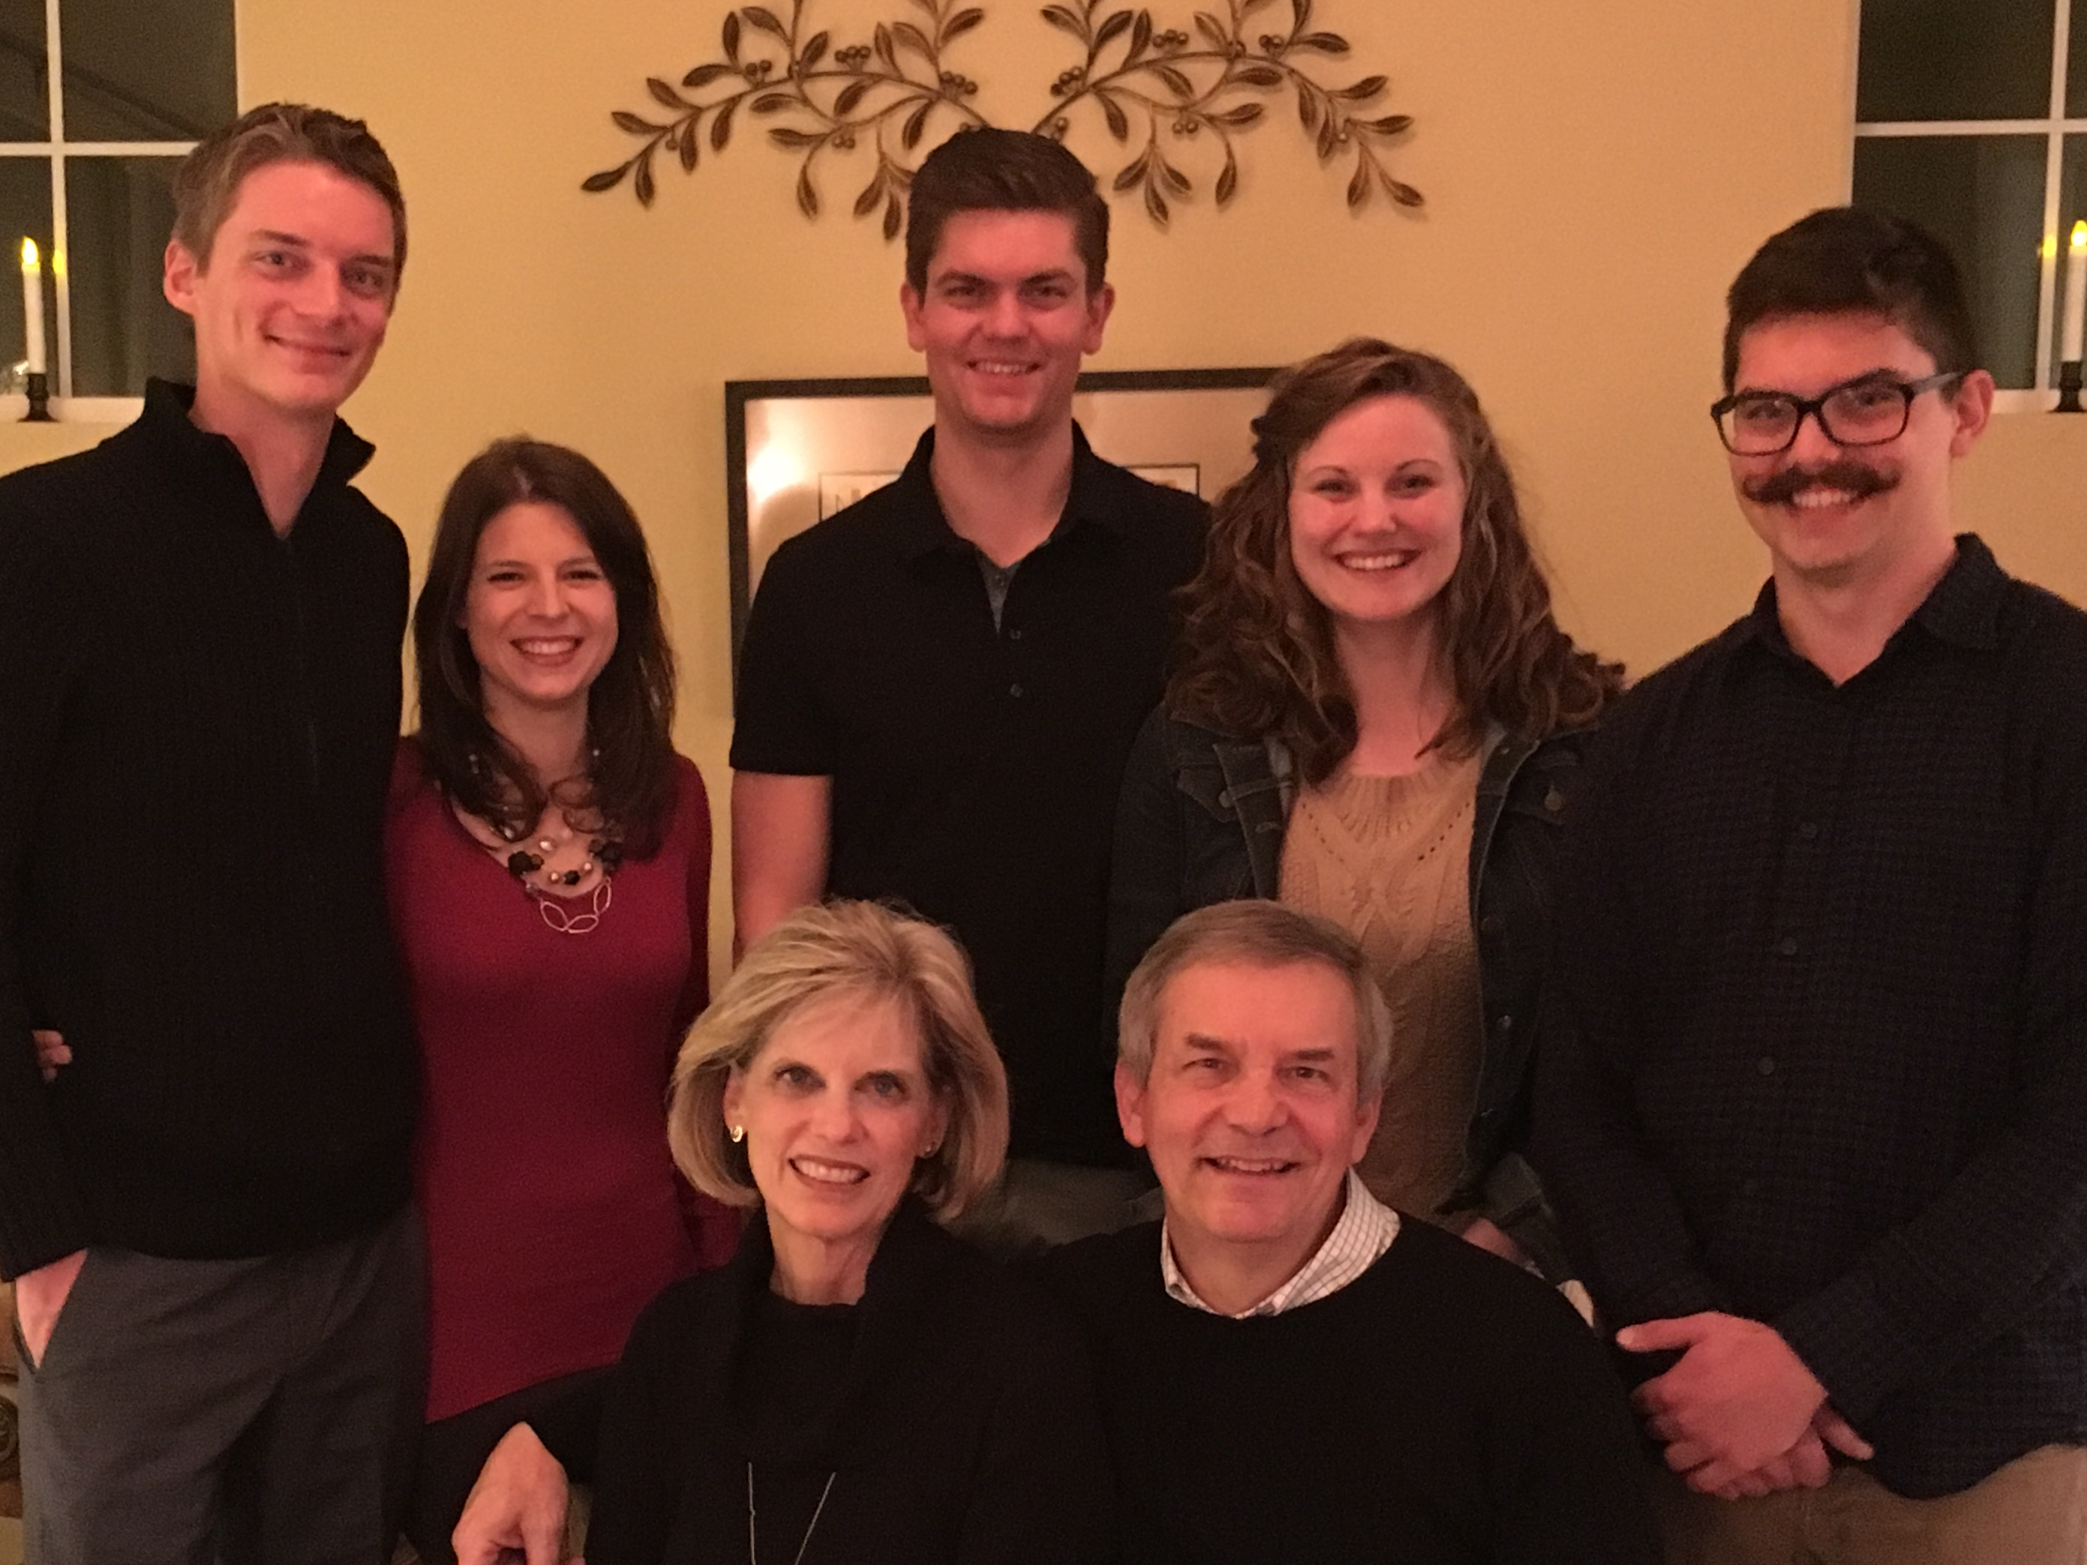
The Griffiths
9 Jan 2016
2017
];BgDk; Nfl;bAk; (28)
N[hd;
(24)
fHl;Lk; fuhTk; (30)
RrDk; upf;Fk;

Slide 13
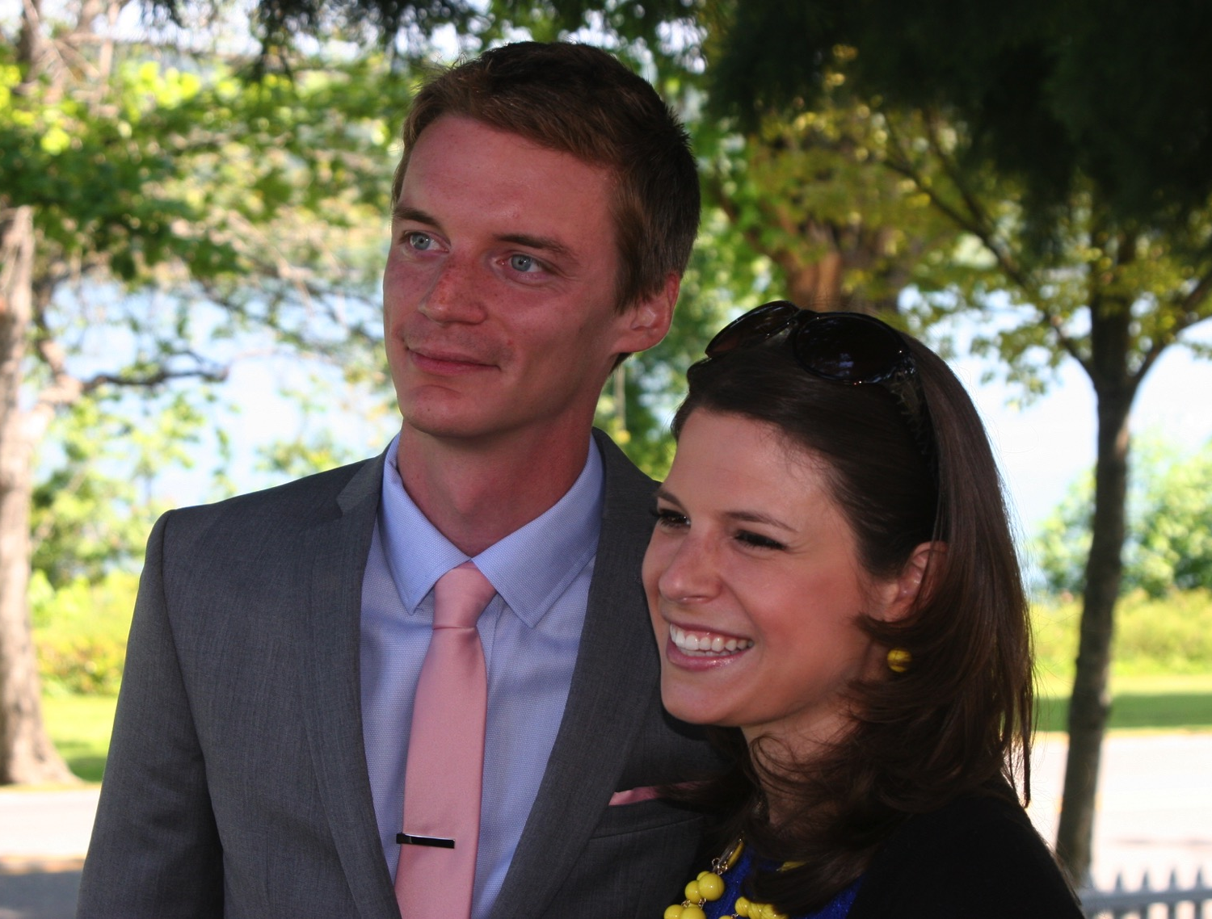
fHl; (30)
(IT) jfty; njhopDl;g fk;gdpapy; Ntiynra;fpwhH. rPl;bypy; trpf;fpwhH.

Slide 14
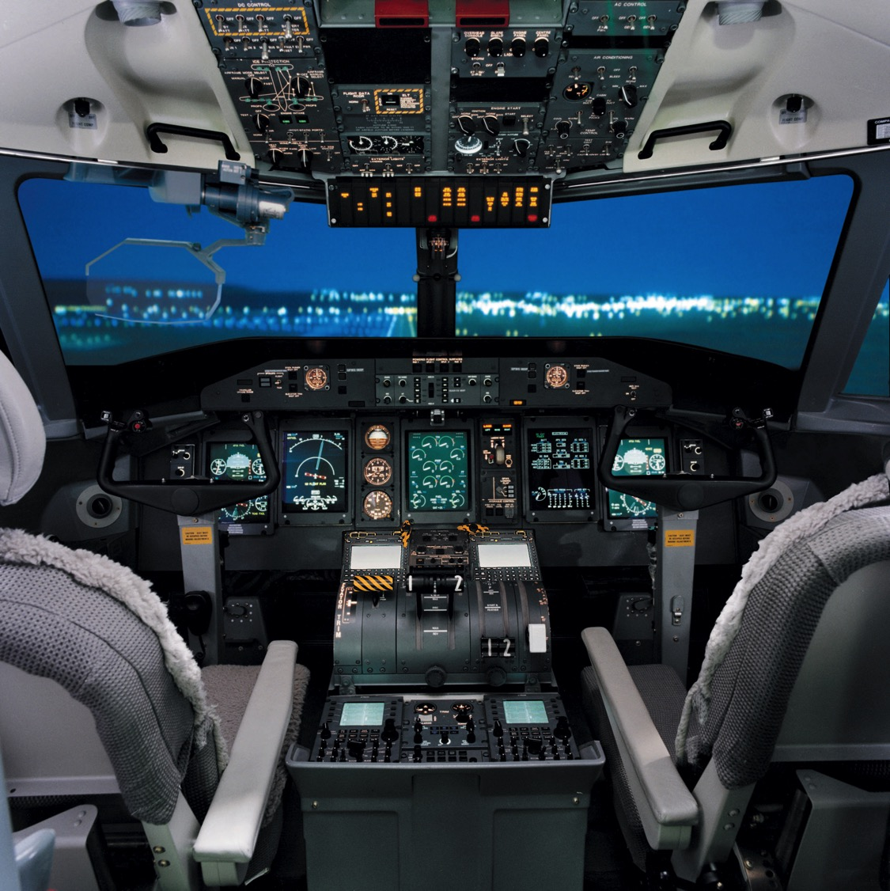
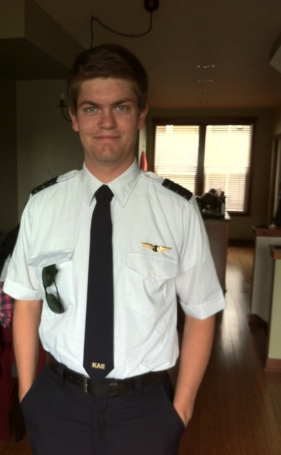
];Bgd; ];gpupl; tpkhd fk;gdpapy; tpkhdpahf gzpahw;WfpwhH.
6

Slide 15
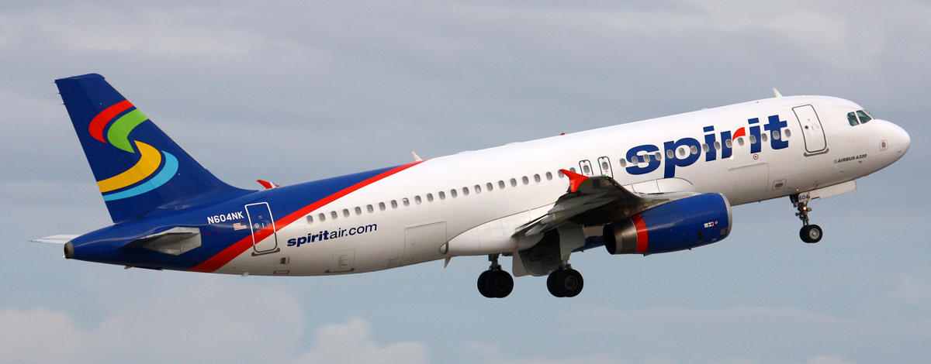
Spirit Airbus A320
8
];BgDila thD}Hj;jp

Slide 16
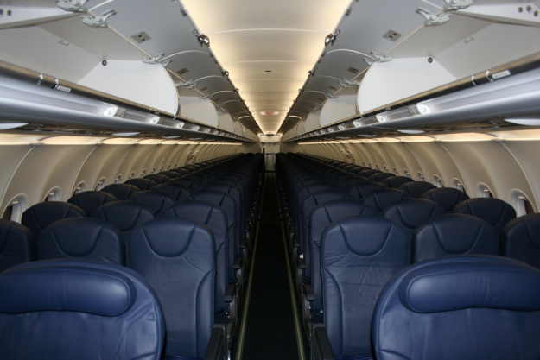
];Bgd; 174 gpuahzpfSld; gpuahzk; nra;thH
8

Slide 17
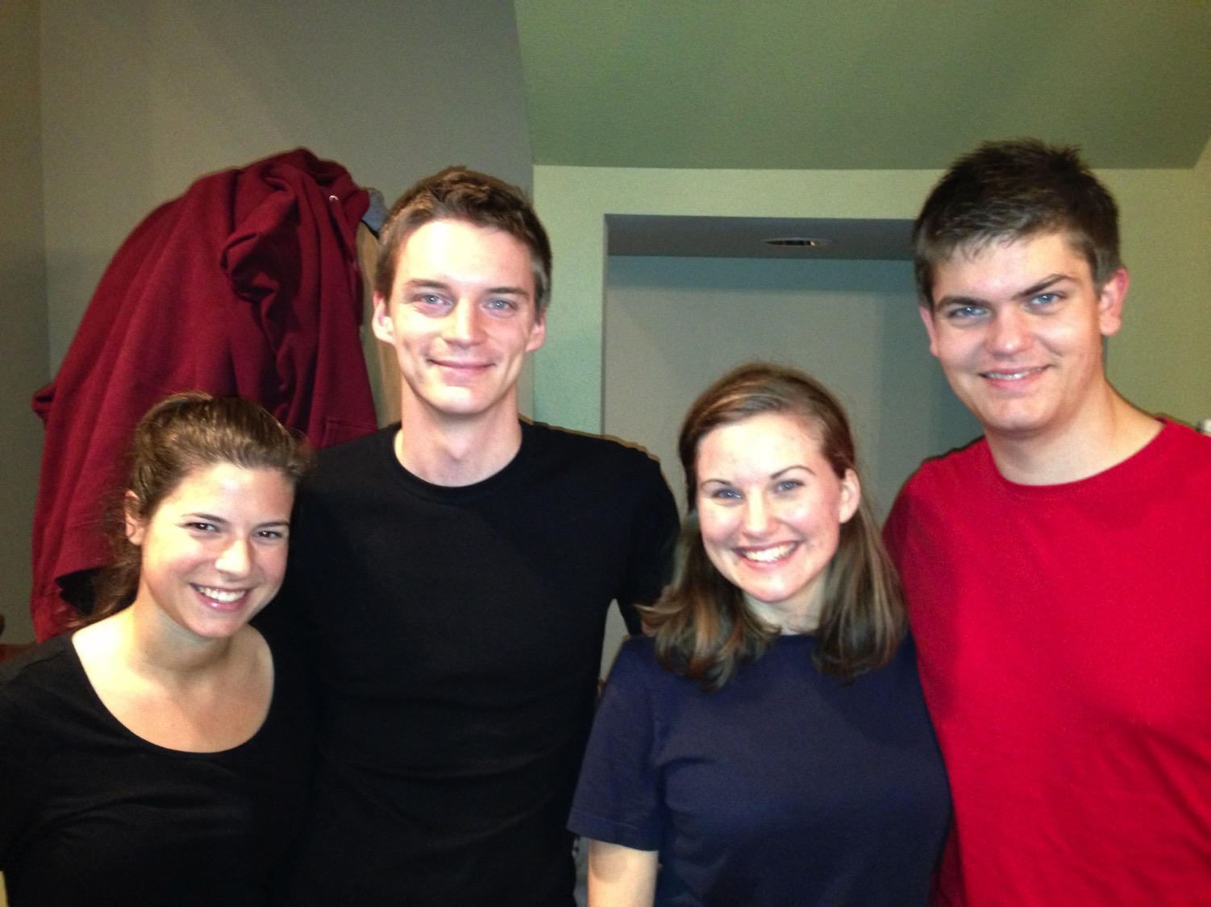
8
fHl;Lk; fuhTk; • ];BgDk; Nfl;bAk;

Slide 18
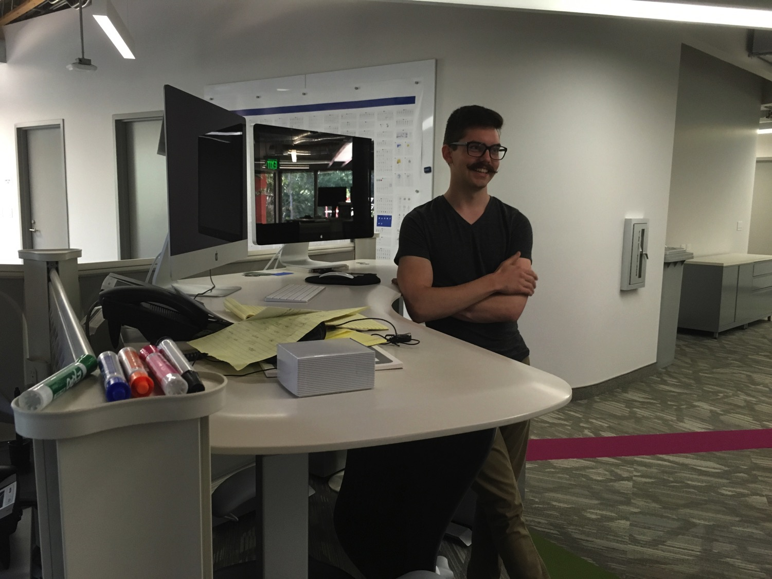

N[hd; (24) tiufiy tbtikg;ghsH> nul;Nyd;l;];> fypNghHdpah
8

Slide 19

vkJ jpUj;J}Jg;gzpafk; …

Slide 20


Crossroads People Aug 2017
I. ,uh[;[pak;
u\;ah
gpuhd;];
nkhq;Nfhypah
N[Hkdp
,j;jhyp
[g;ghd;
nejHyhe;J
nfhupah
nygdhd;
N`hq;nfhq;
jha;thd;
fdlh
rPdh
kpad;khH
vfpg;J
,e;jpah
I.mnkupf;fh
kNyrpah
gpypg;igd;];
rpk;ghg;Nt
rpq;fg+H
Epa+rpyhe;J
CIC
,e;NjhNdrpah
Notes:
Our Aug 2017 church 40 people stem from 13 different countries around the world (44 vcards). Canada (Gloria Lee), China (Charles), Netherlands (Dies & Desiree), Hong Kong (Larry Pun), Cynthia (India), Rena (Indonesia), Yoshie & Kaori (Japan), Naomi (Malaysia), Peng (Myanmar), Miriam (USA), Micah (Philippines), Singapore (Albina), Sarah (UK)
This does not include people who have recently attended only once: Dowon (Korea)
Nor does it include missionaries living back in their countries but still are members of CIC: Maple (Taiwan), Budmaa (Mongolia)

Slide 21

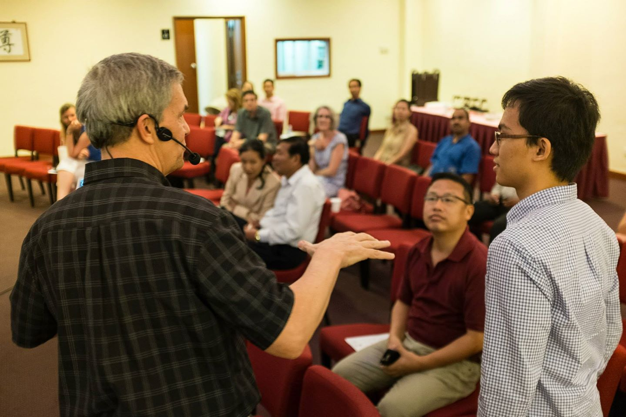
Our People
2017: 10 ehLfspypUe;J 40 egHfs;
Notes:
We also helped start Crossroads International Church in 2006 where I serve as the pastor-teacher.

Slide 22

Our People
Ntjtrdj;jpD}lhd Nghjid
Notes:
RICK: Yes, we helped start Crossroads International Church in 2006 and I serve as the pastor-teacher.

Slide 23

Our People
SBC khztHfspd; Mya gzp
Notes:
One special joy is mentoring my students who serve with us at church and led ministries to youth, children, home groups, and the worship team.

Slide 24
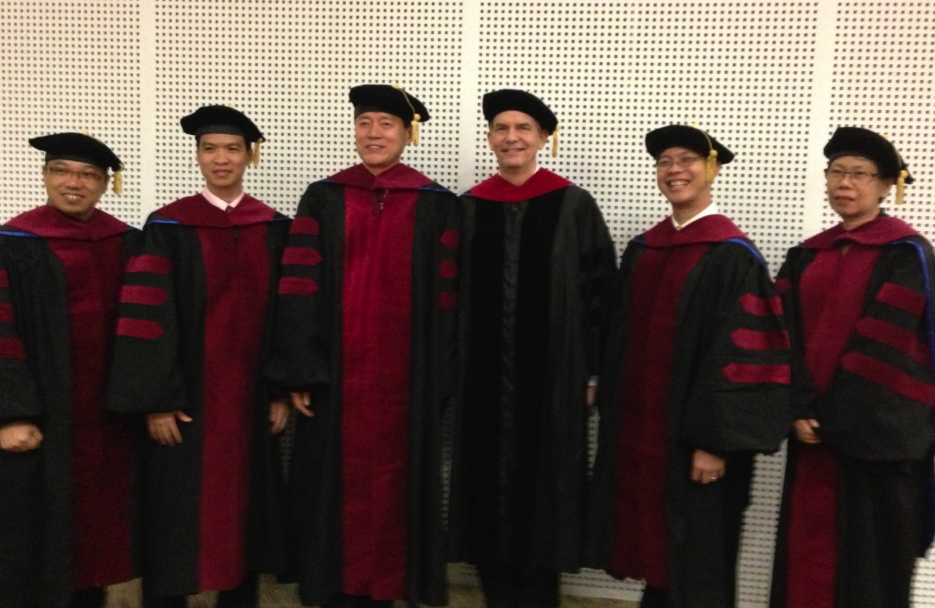
Copa fyhepjp gl;lgbg;GfSf;fhd (DMin) gzpg;ghsuhf ehd; gzpahw;WfpNwd;
Notes:
I'm also the director of the doctoral program at SBC that trains about 80 seminary professors and pastors throughout Asia in English and Chinese. Generallly each year about 5 of them received their Doctor of Ministry degree.

Slide 25
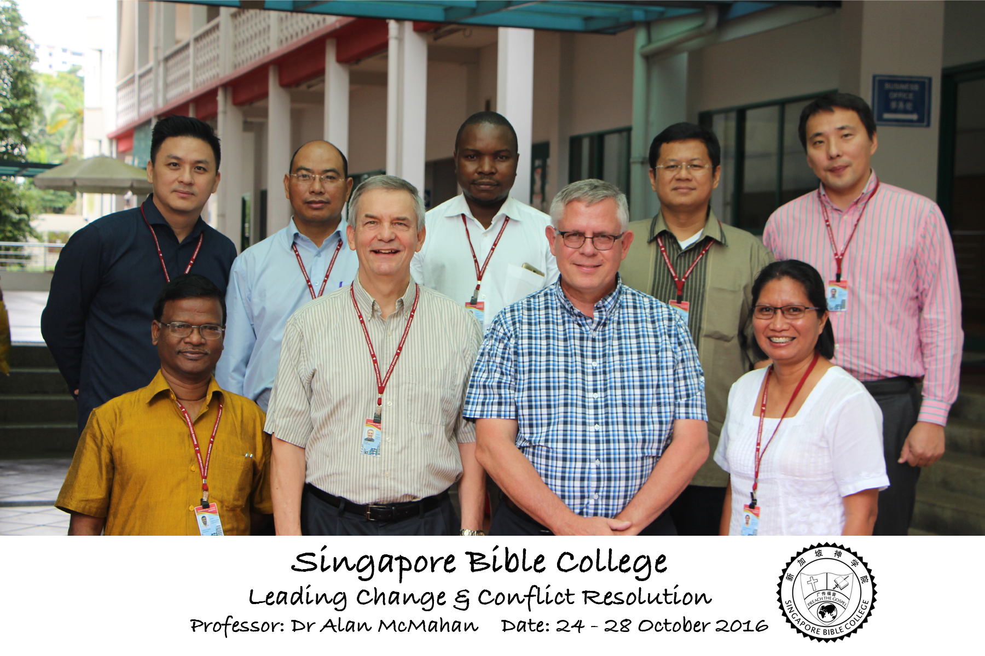
Leading Change & Conflict Resolution
(Dr. Alan McMahan Oct 2016)

Slide 26
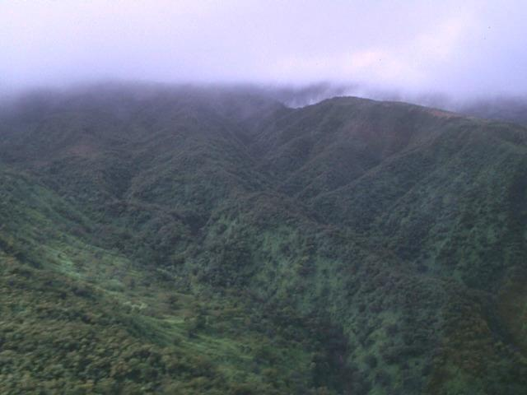
The Lord Reigns
The Lord reigns, the Lord reigns,
the Lord reigns let the earth rejoice
let the earth rejoice let the earth rejoice
Let the people be glad;
that our God reigns.
(repeat)

Slide 27
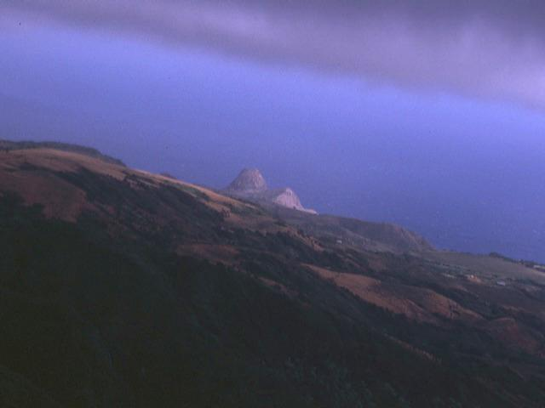
The Lord Reigns
The heavens declare His righteousness.
The people see His glory
For You, O Lord, are exalted
over all the earth
over all the earth.

Slide 28
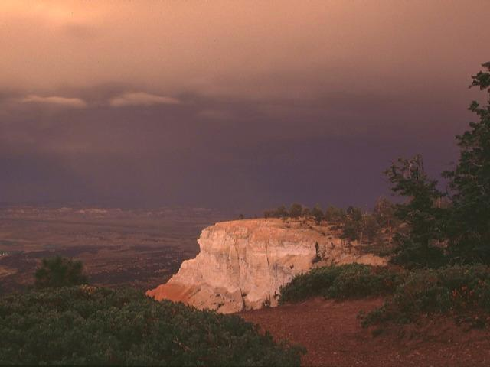
The Lord Reigns
The Lord reigns, the Lord reigns,
the Lord reigns let the earth rejoice
let the earth rejoice let the earth rejoice
Let the people be glad;
that our God reigns,
our God reigns,
our God reigns,
our God reigns.

Slide 29
ghl tptuzk;
vii
fpwp];Jtpd; gpwg;G tiuapyhd fhyj;jpd; murpay;> r%f> nghUshjhu> rka> ,yf;fpa mgptpUj;jp mk;rq;fs; kw;Wk; Kjyhk; E}w;whz;L Mjpj;jpUr;rigf;Fk; cyfpw;Fk; jhf;fk; nrYj;jpa Ntjhfk jiuj;Njhw;w kjpg;gPLk; fhuzpfSk;.

Slide 30
ghlf;Fwpf;Nfhs;
vii
,g;ghlj;jpl;lj;ij G+Hj;jp nra;tjd; %yk; khztHfs;……
Gjpa Vw;ghL> etPd jpUr;rigfspd; cyfshtpa jpUj;J}Jg;gzpia Gupe;Jf;nfhs;tjw;F vt;thW ,];uNtypdJk; cNuhkpdJk; jiuNjhw;w mikg;G cjTfpwJ vd;gij mwpe;Jnfhs;tH.
gioa Vw;ghl;L vOj;Jf;fis murpay;> r%ftpay;> rka> nkhopapay; gpd;dzpfis cs;slf;fpa tuyhw;W mr;Rf;fspypl;L mtw;iw Gjpa Vw;ghl;bw;Fk; jw;Nghija r%fj;jpw;Fk; gpujpapLtH.
Nuhk fpNuf;f fyhr;rhukag;gLj;jy; kw;Wk; a+j r%fj;jpw;$lhf Gjpa Vw;ghl;il Gupe;Jf;nfhz;L jpUr;rigf;Fk; jw;Nghija r%jhaj;jpw;Fk; mjid xg;gply;

Slide 31

nray;Kiw Ntiyfs;
vii
thrpg;G (33%)
FW tpdhtpil (33%)
nkhopngaHg;G PPT (33%)

Slide 32
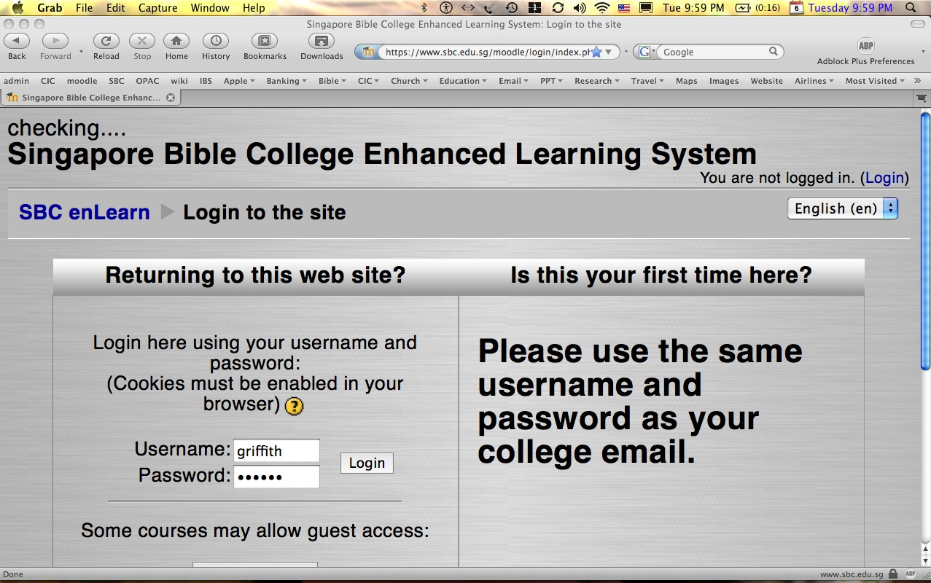
vt;thW ,t;tiyjsj;ij gad;gLj;JtJ…
1
Log on at sbc.edu.sg/moodle/login/index.php
Type your normal SBC username
Type normal SBC password
Click on the WNT course
Take your quiz or post a message

Slide 33


FW tpdhtpilfSf;Fk; guPl;irfSf;Fk; ghlE}y; gad;gLj;j mDkjpapy;iy

Slide 34
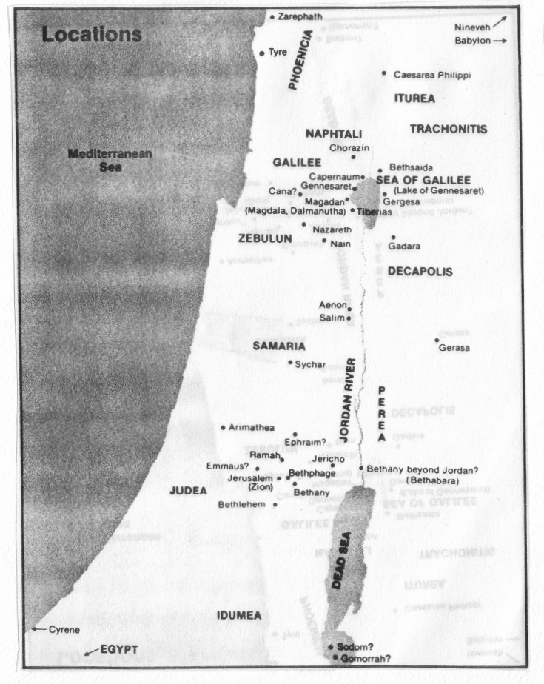
Quiz #1
2
J}uk; iky;
vUrNykpypUe;J :
ngj;jhdpah 2
ngj;yNfk; 6
nrrupah gpypg;G 105
fhdh 69
fg;gHe$k; 85
vk;kht+H 7
vupNfh 15
NahHjhd; 21
kj;jpaj;jiufly; 40
rPNjhd; 130
rPfhH 31
jPU 106
rhupghj; 118
fg;gHe$kpypUe;J :
ngj;rhapjh 6
nrrupah gpypg;G 27
fhdh 16
ehaPd; 22
kj;jpaj;jiufly; 32
ehrNuj;J 23
rhupghj; 45
jPU 37
FWtpdhtpil #1: ew;nra;jp E}y;fspy; cs;s midj;J Gtpapay; jiuNjhw;w mk;rq;fs;

Slide 35
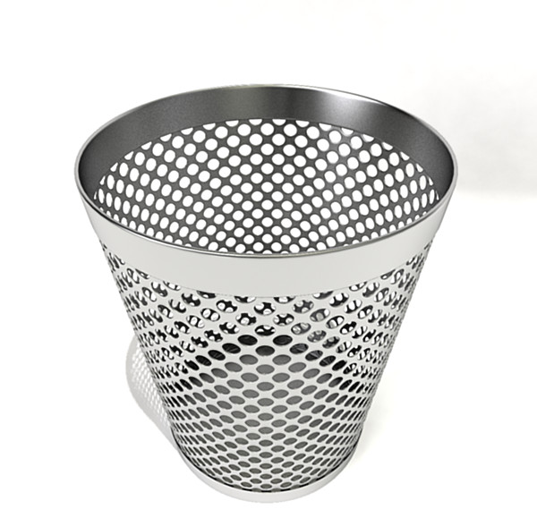
nra;Kiw Ntiyj;jpl;lk;

Slide 36

PowerPoint (945 slides) khztH ghlE}y; (100 gf;fq;fs;)
MrpupaH ifE}y; (400 gf;fq;fs;)
TBB cgfuzq;fs;
Mq;fpyk; • rPdnkhop • `pe;jp • ,e;NjhNdrpankhop • nfhupankhop • kNynkhop • nkhq;Nfhypankhop • u\;ankhop • ];ghdpankhop
epiwTnra;ag;gl;Ls;sJ.
A Presentation of The Bible…Basically Ministries International Inc. Fort Worth, Texas
BibleBasically.org
©2004 TBBMI
8.0.01.
04

Slide 37
Vidait
xvi
tFg;giwapy; Fwpg;ngLj;jy;
njhlHGfSf;F
At SBC box L19 or phone (6559-1513)
Home address is Block 2-302
Mobile: +65 9113-7090
E-mail: griffith@sbc.edu.sg
My office hours are after chapel (except Tuesdays)
Let's have lunch too!
BibleStudyDownloads.org

Slide 38

Gjpa Vw;ghl;L kjpg;gPLk; gpd;dzpAk;
xv
Gtpapay;
,yf;fpa cs;slf;fk;
Gjpa Vw;ghl;L kjpg;gPL
  MrpupaH> jpfjp
  tpthjk;
  Gj;jfq;fspd; fhytupir
  jdpj;Jtkhd Fzhjprak;
murpay;
(tuyhW)
rka cs;slf;fk;
r%f> nghUshjhu cs;slf;fk;

Slide 39
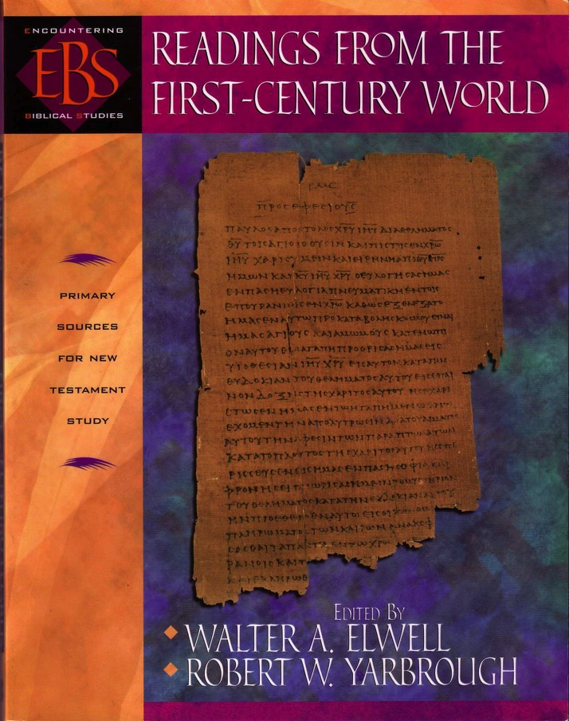
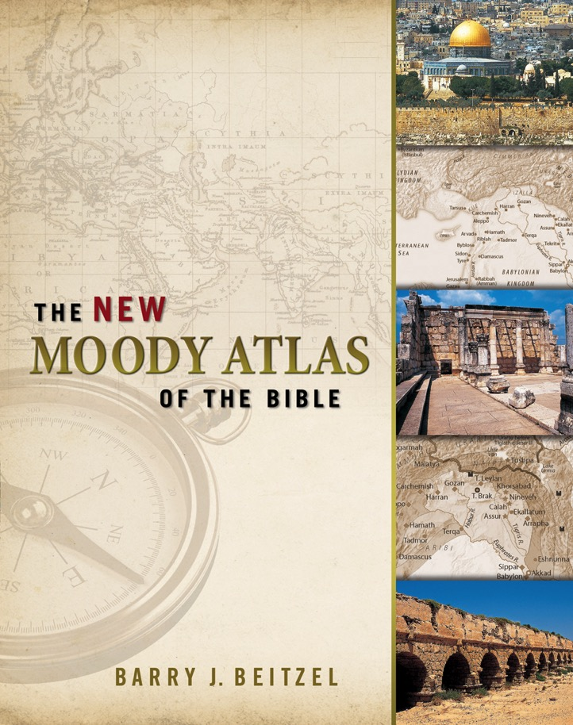
vkJ gpujhd ghlf;Fwpg;G
ePq;fs; mNefkhf Kjw;ju Fwpg;Gfis thrpg;gPHfs;

Slide 40


Gjpa Vw;ghl;L gpd;dzpfspd; ,izg;G : BibleStudyDownloads.org
,g;ghlf;Fwpg;Gfis ,ytrkhf ngw;Wf;nfhs;s
Notes:
NT Backgrounds (nb)

